Slide 1

BUYERS PERSONA AS PER HUBSPOT TEMPLATE
https://www.fragrantiz.in/

Slide 2
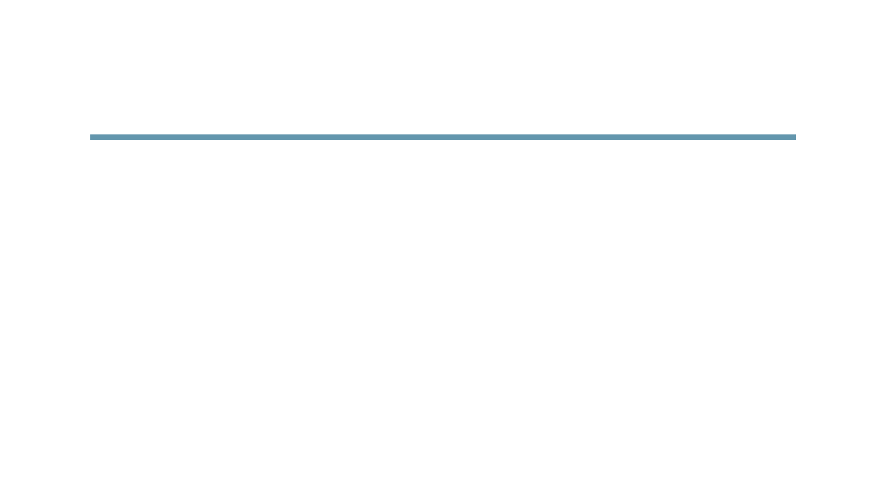
By completing and fine-tuning these 7 topics your Persona will emerge.
1. Persona goals - concrete objectives.
2. Persona demographics - age, place, role name.
3. Persona pain - frustrations, concerns, barriers, challenges.
4. Persona media & device preference - most used sources or devices.
5. Persona image – photographic impression
6. Persona role & responsibility - reports to, seniority on job.
7. Persona biography - narrative of daily life or past events.

Slide 3
3 PERSONAL LISTED BELOW

Slide 4
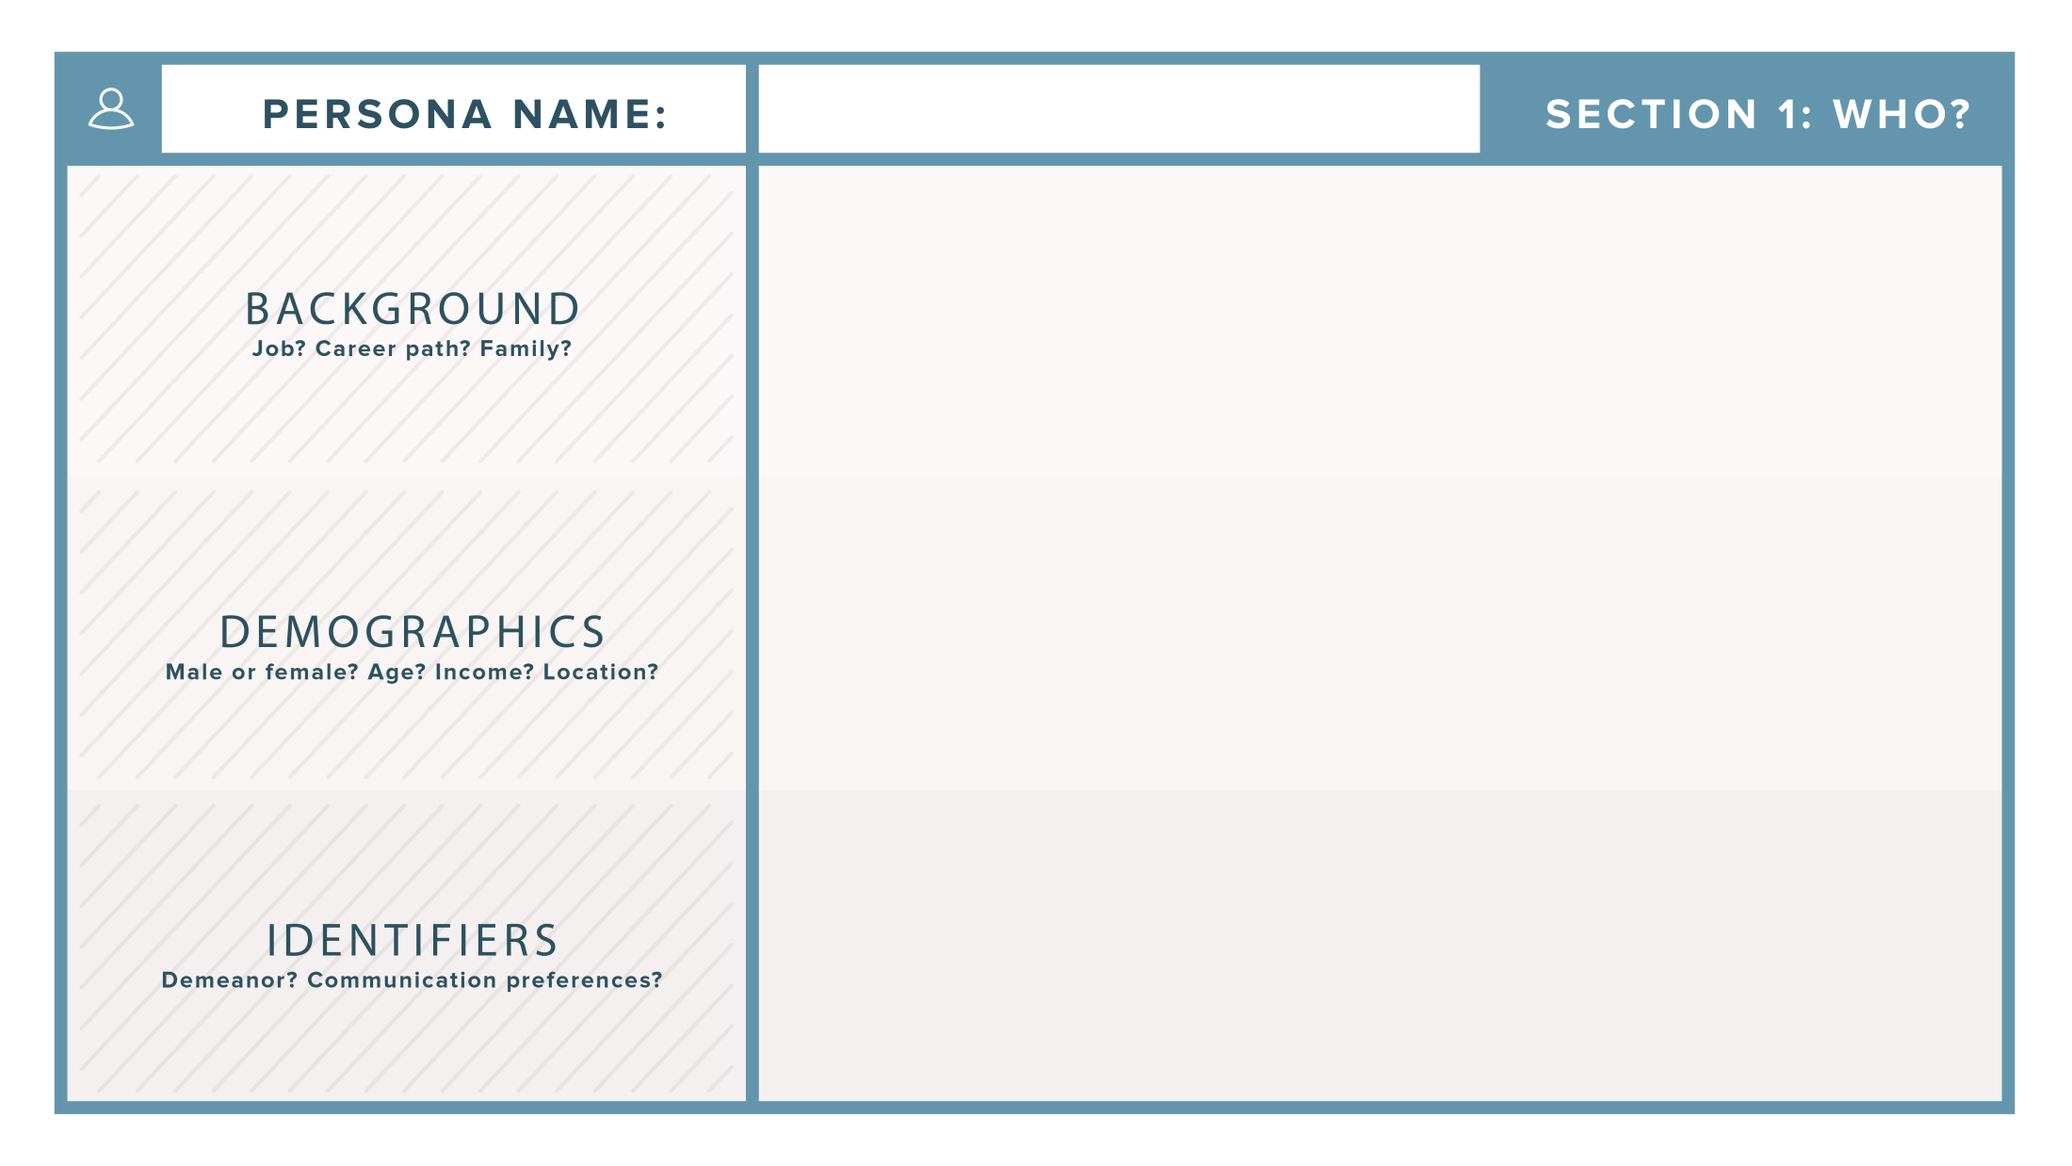
1
Sunil Choudary
Senior Software Engineer and Team leader
Worked at the same company for 10 years.
Married with 2 children (3 and 6)
2
Male
Age 30-45
Dual HH Income: Rs.10Lac
Bangalore
3
Calm demeanor
Whatsapp / Mail / Call
Asks to receive collateral mailed/printed
4

Slide 5
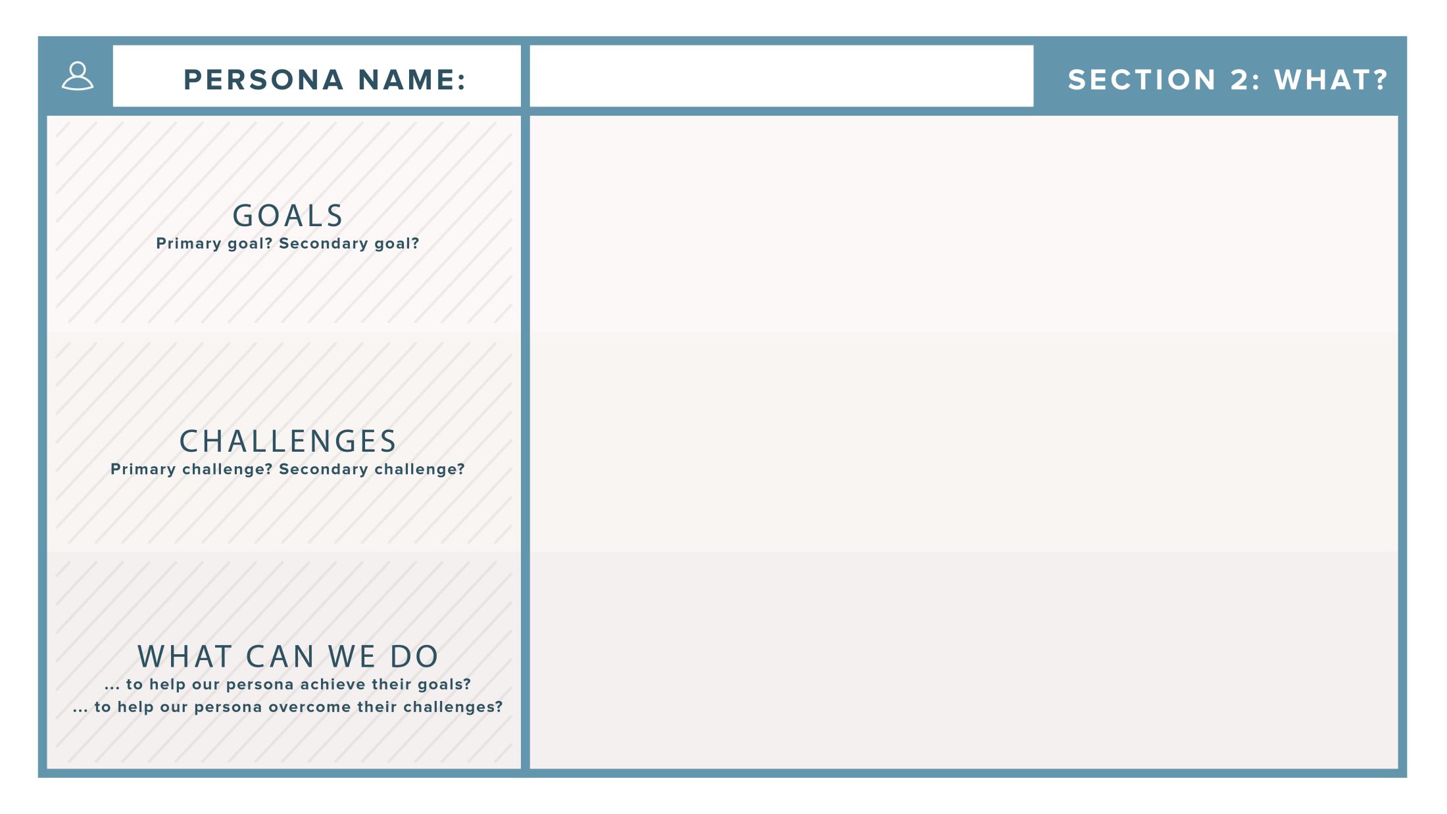
Sunil Choudary
Manage the team and meet deadline
Plan and design new projects lifecycles
5
Coordination of team members and client handling
Monthly targets
6
Make it easy to manage all employee data in one place
Integrate with server and remote support
7

Slide 6
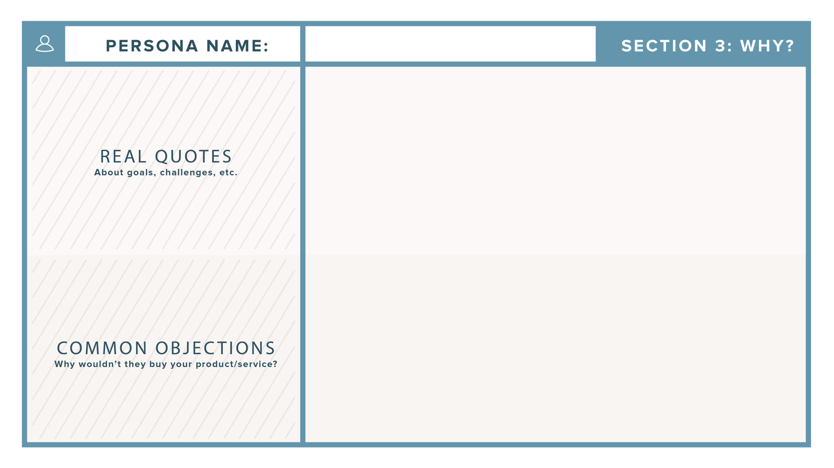
Sunil Choudary
“It’s been difficult getting company-wide adoption of new technologies in the past.”
“I don’t have time to train new employees on a million different databases and platforms.”
“I’ve had to coordinate and arrange many client meetings, project presentation with refreshing face even in end of the day also”
8
Cannot meat Deadline or project stuck on the way.
I want to have to train the entire team on how to use a new system.
9

Slide 7
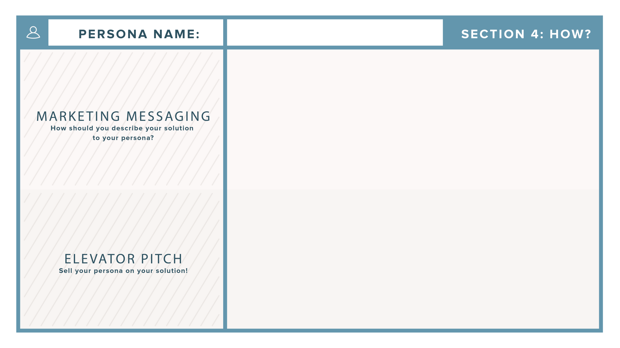
Sunil Choudary
10
Team leader and Senior technical person
We give you an intuitive database that integrates with your existing software and platforms, and lifetime training to help new employees get up to speed quickly.
11

Slide 8
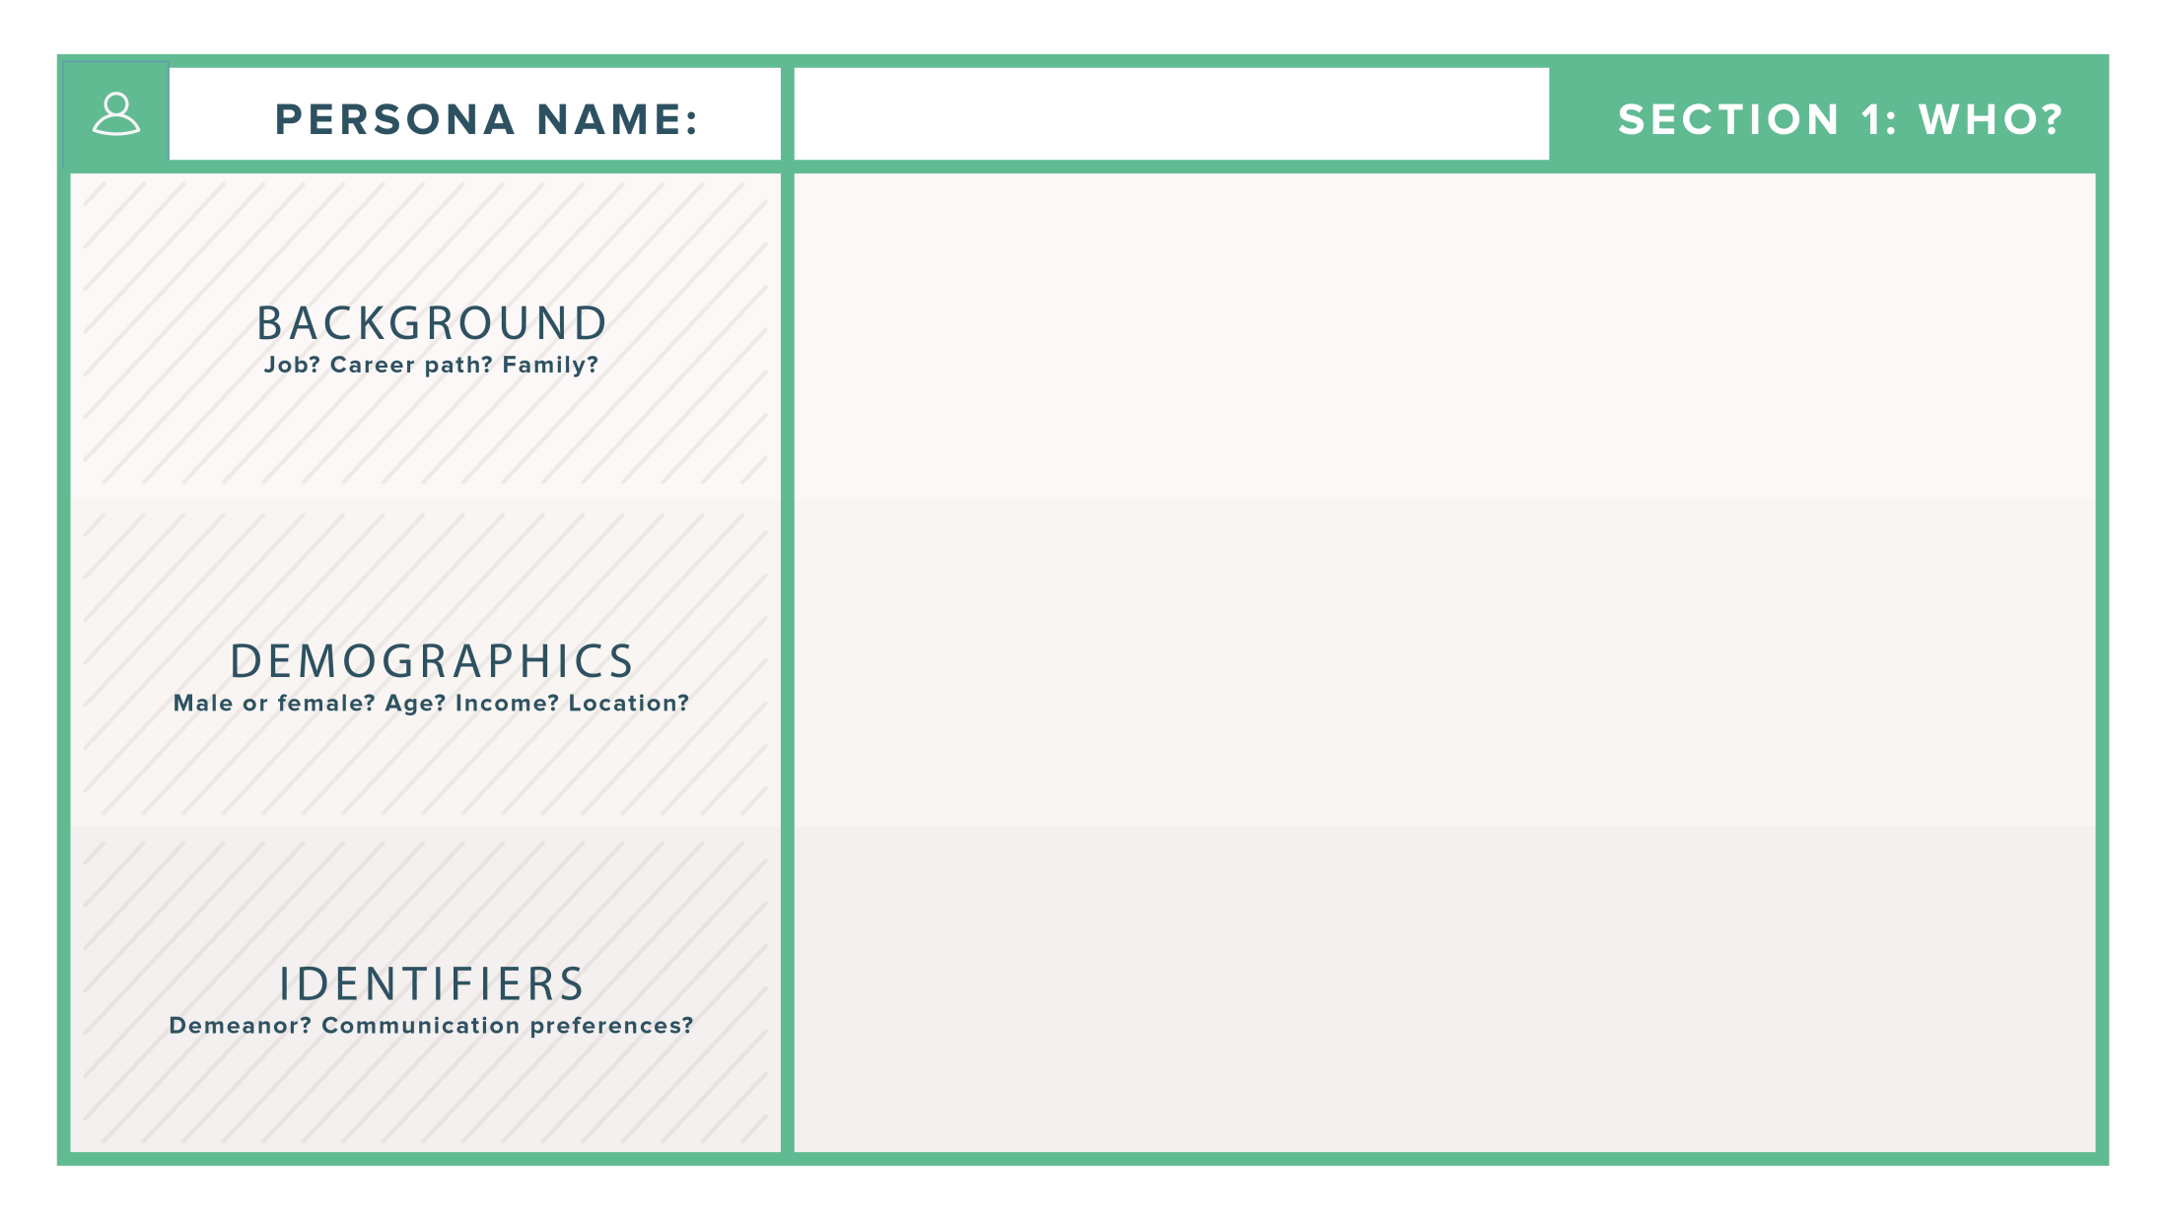
Shazia
College going student
To complete Medical Course
Unmarried
Female
20-22
Not earing regular, some parttime jobs only
Pune
Whatsapp or email

Slide 9
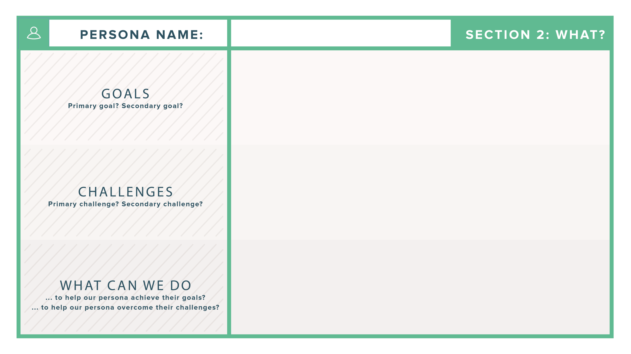
Shazia
To become a Medical Doctor
To work for needy people
Patient's health reaction after treatment
Co-workers attitudes
Lets complete the course first, am waiting to get placed in any good hospital.
Co-workers attitude never mind, but recover of patient is important focus.

Slide 10
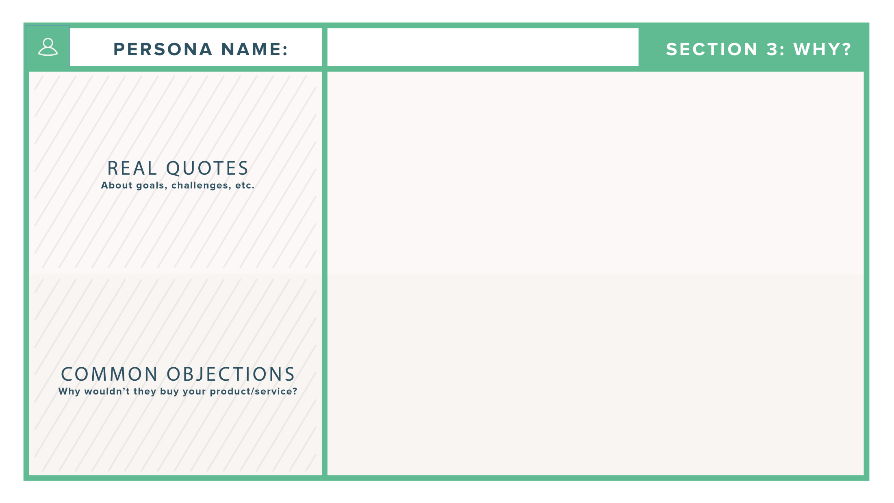
Shazia
Medical profession is really great task, after getting this degree, un countable things I can to for people.
Saving a life through our hand is really amazing and can see the god or feel the god in many times.
We serving only humans not cast, color, political or financial power.
Huge medical fees of hospitals.

Slide 11
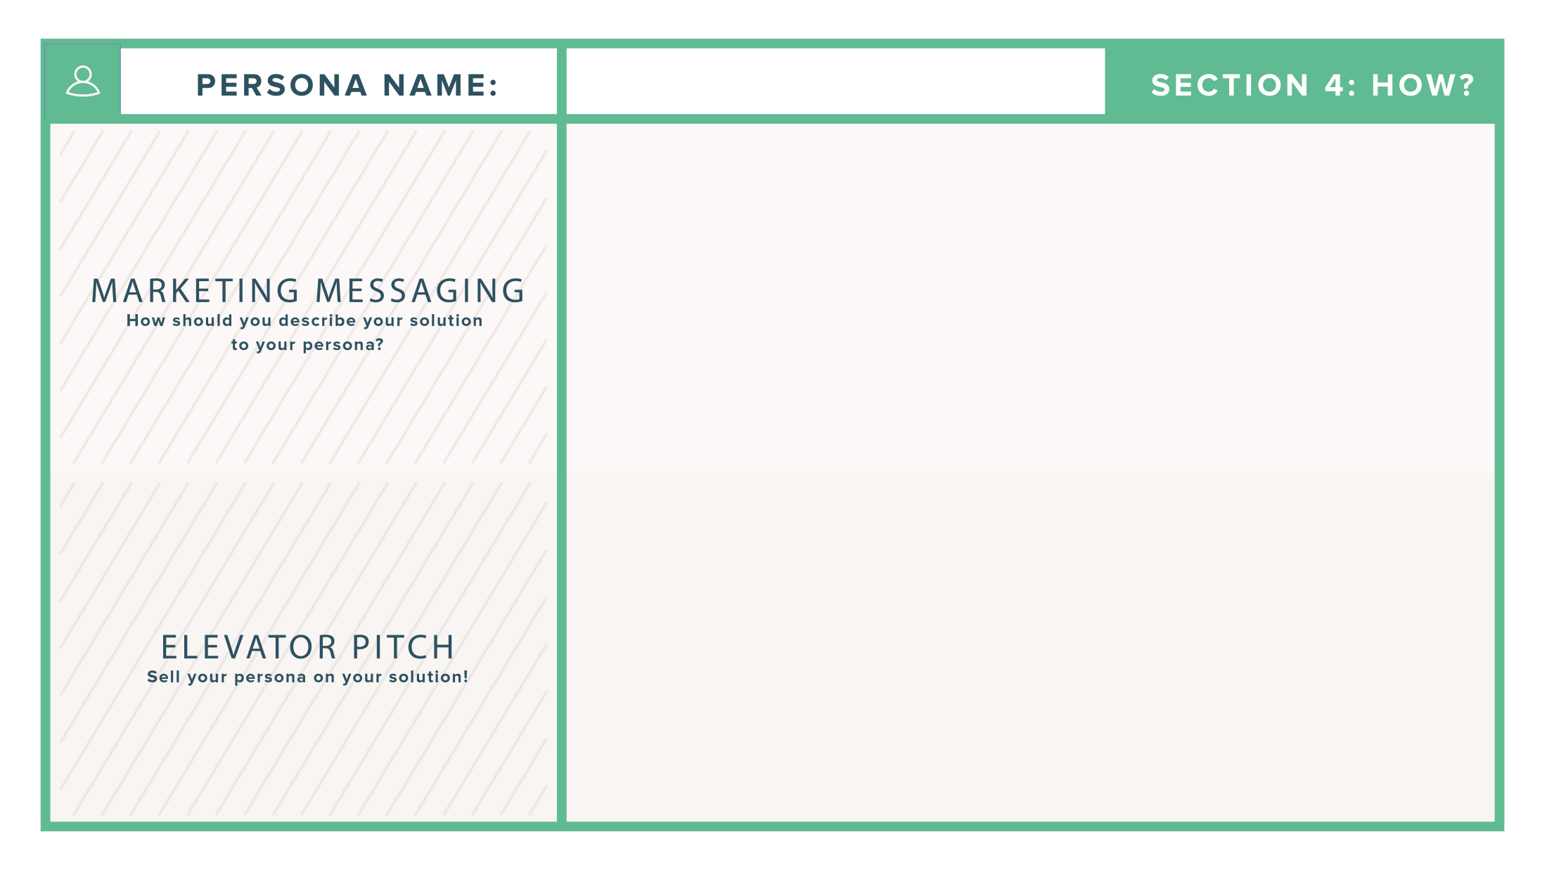
Shazia
Successful completion of medical degree.
Giving a innocent service to all patients infront of me.

Slide 12
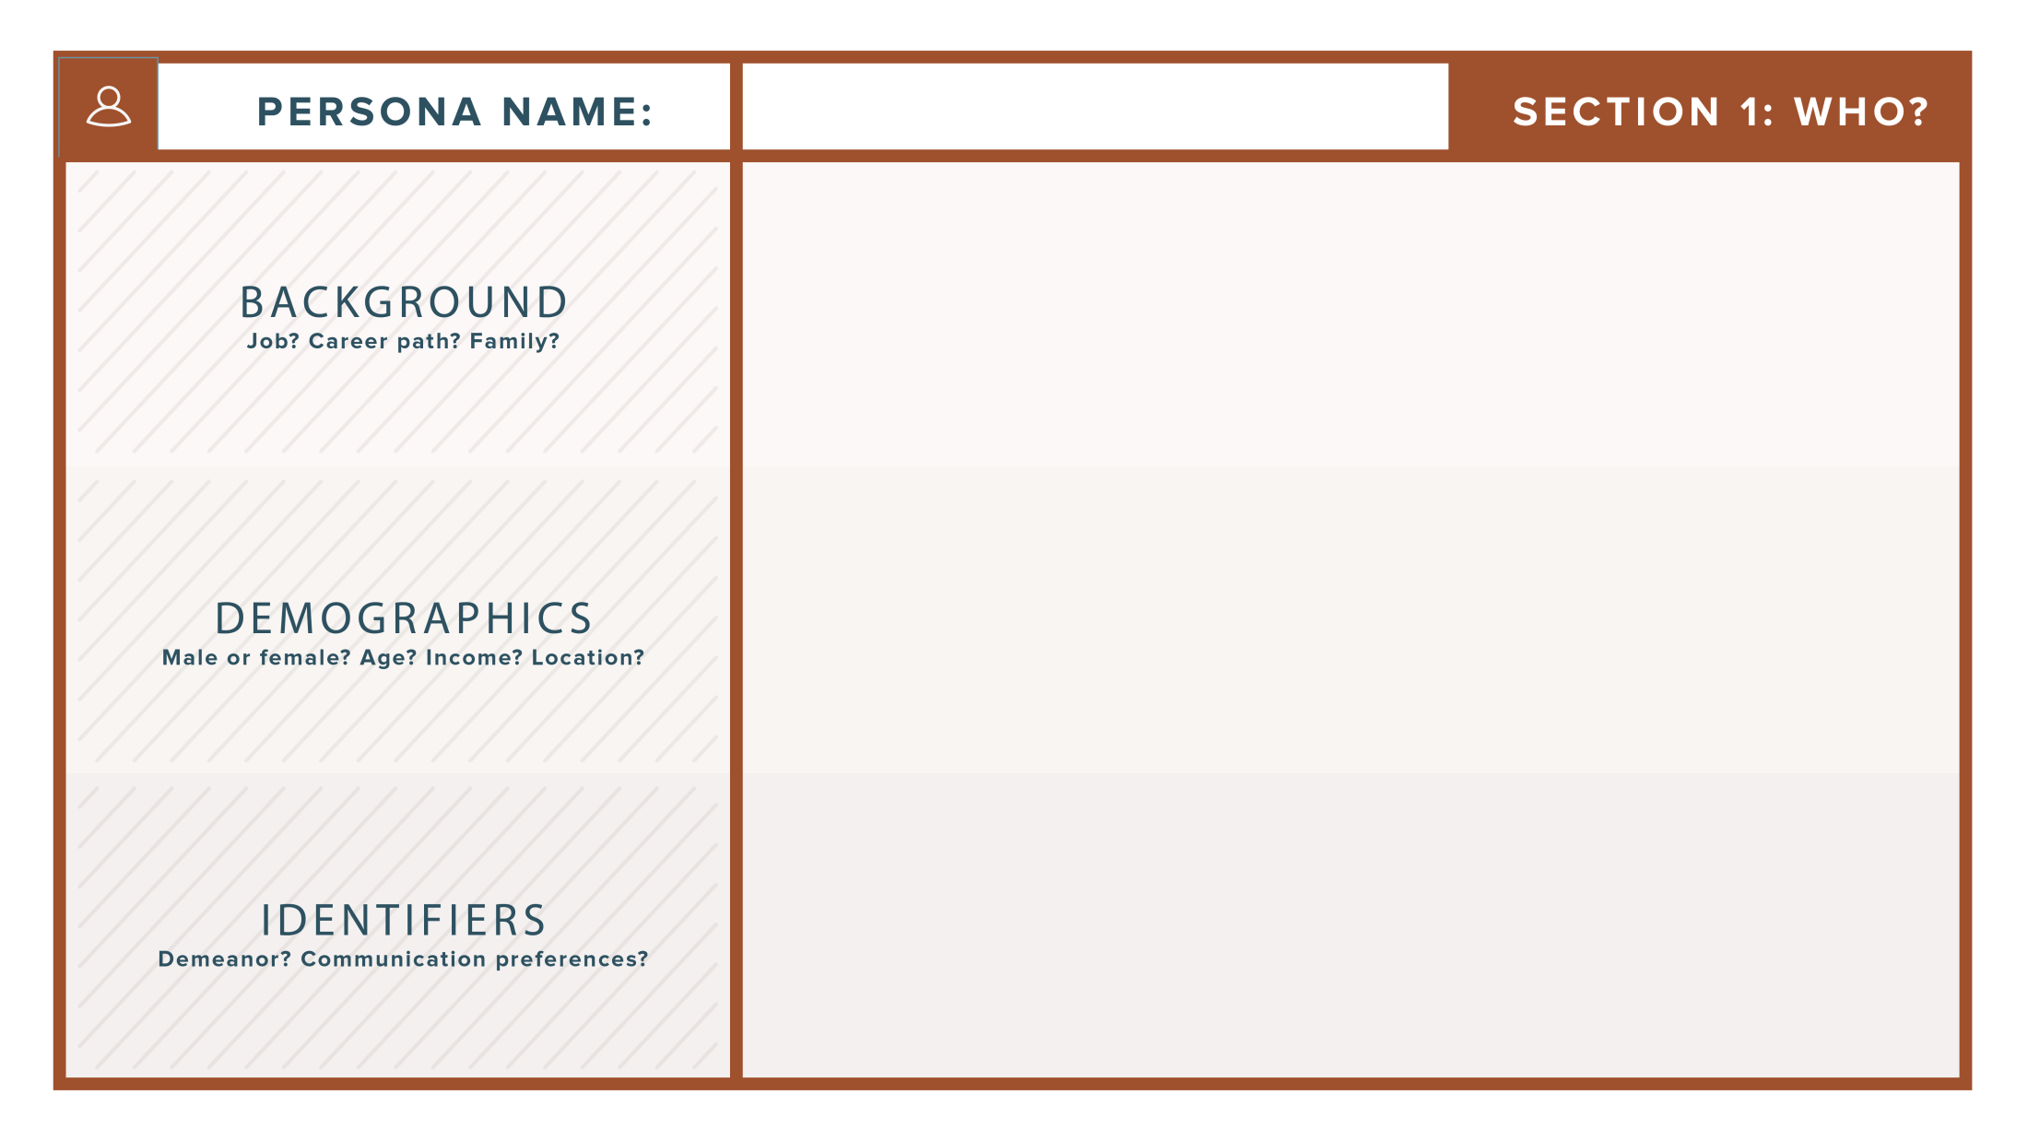
Aby Anna
Marketing job, Zonal head of Vguar Powers
Started the career as Marketing excetive from another reputed company. Now it become 15 years almost.
Married with 1 kid
Male
35-40
Per annuam – 15Lac
kerala
Smart behavior
Call

Slide 13
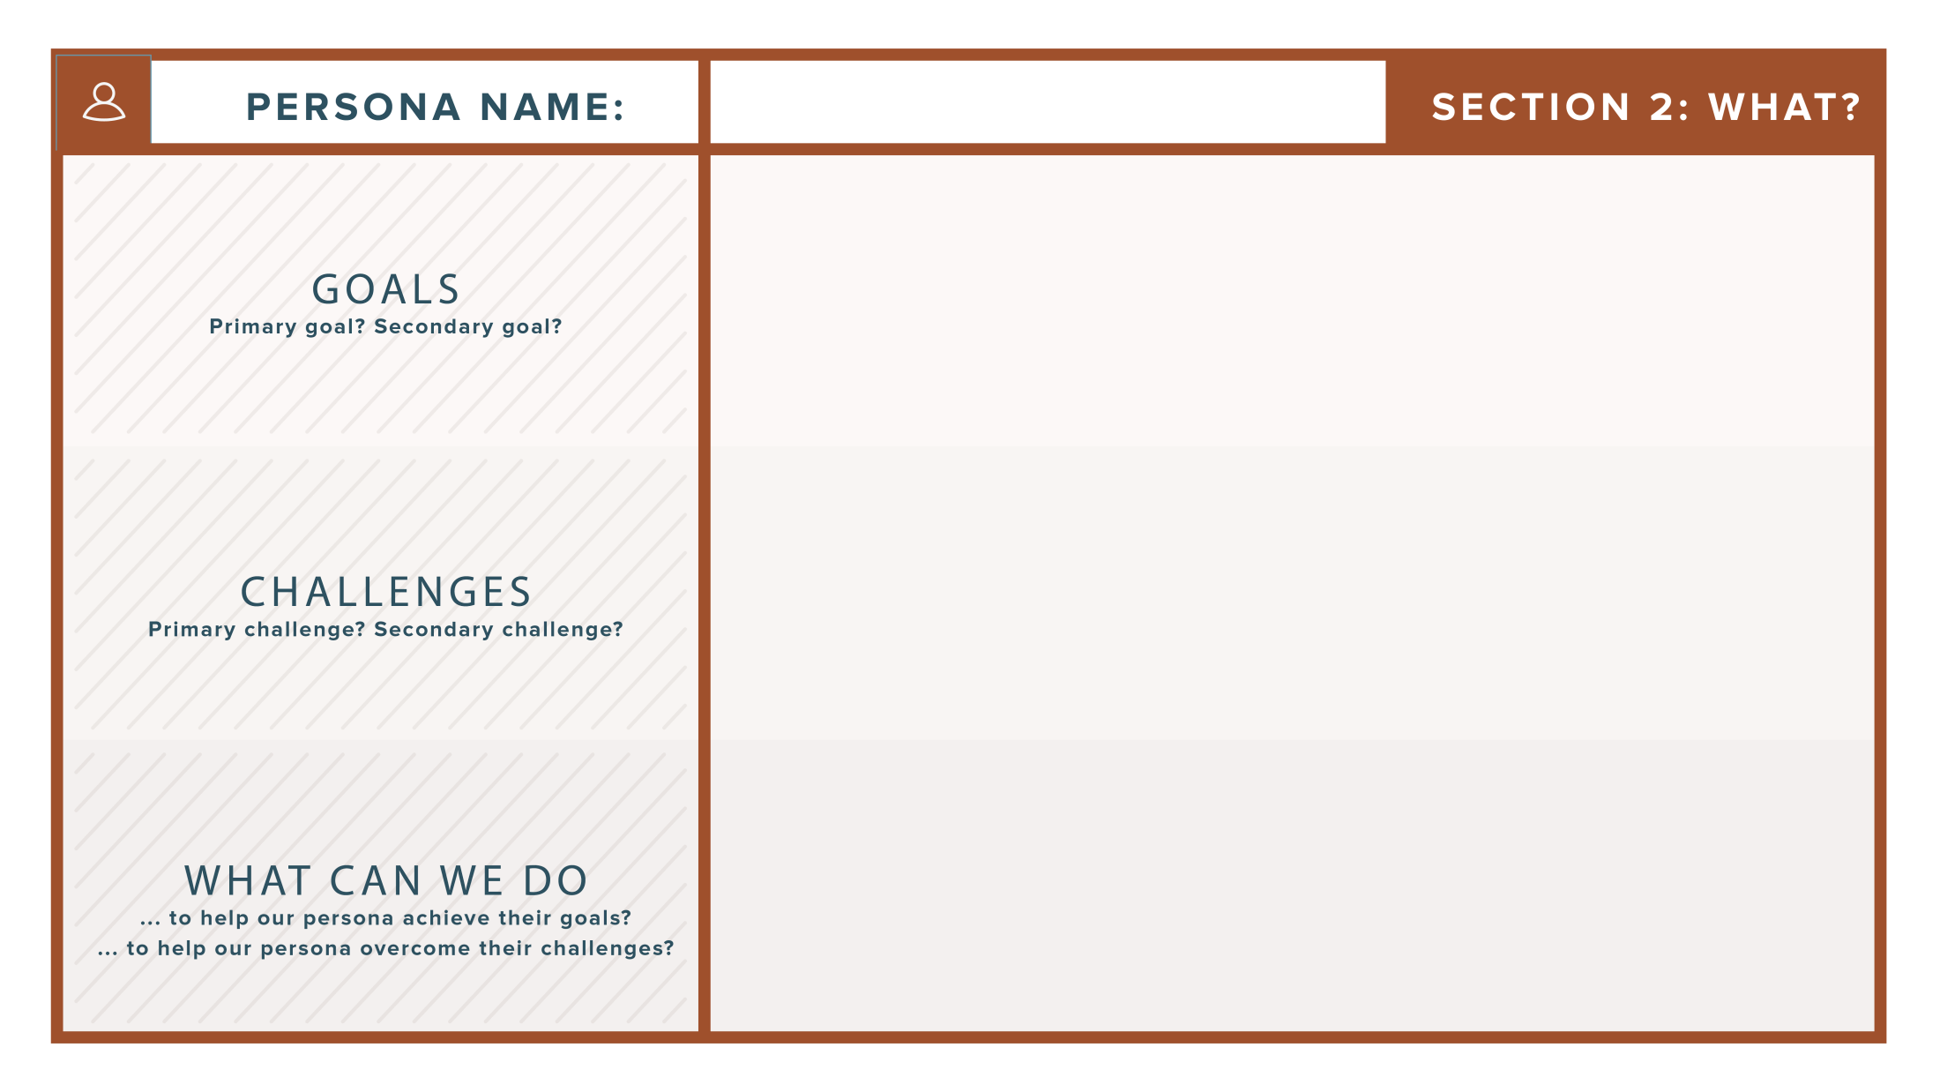
Aby Anna
Finding new markets for products
Keeping existing customers
Market survey on the basis of products and customers
Competition from other brands
Market analysis and finding new markets
Make it easy to manage 3 districts, in a single zonal.
Integrate with server and remote support

Slide 14
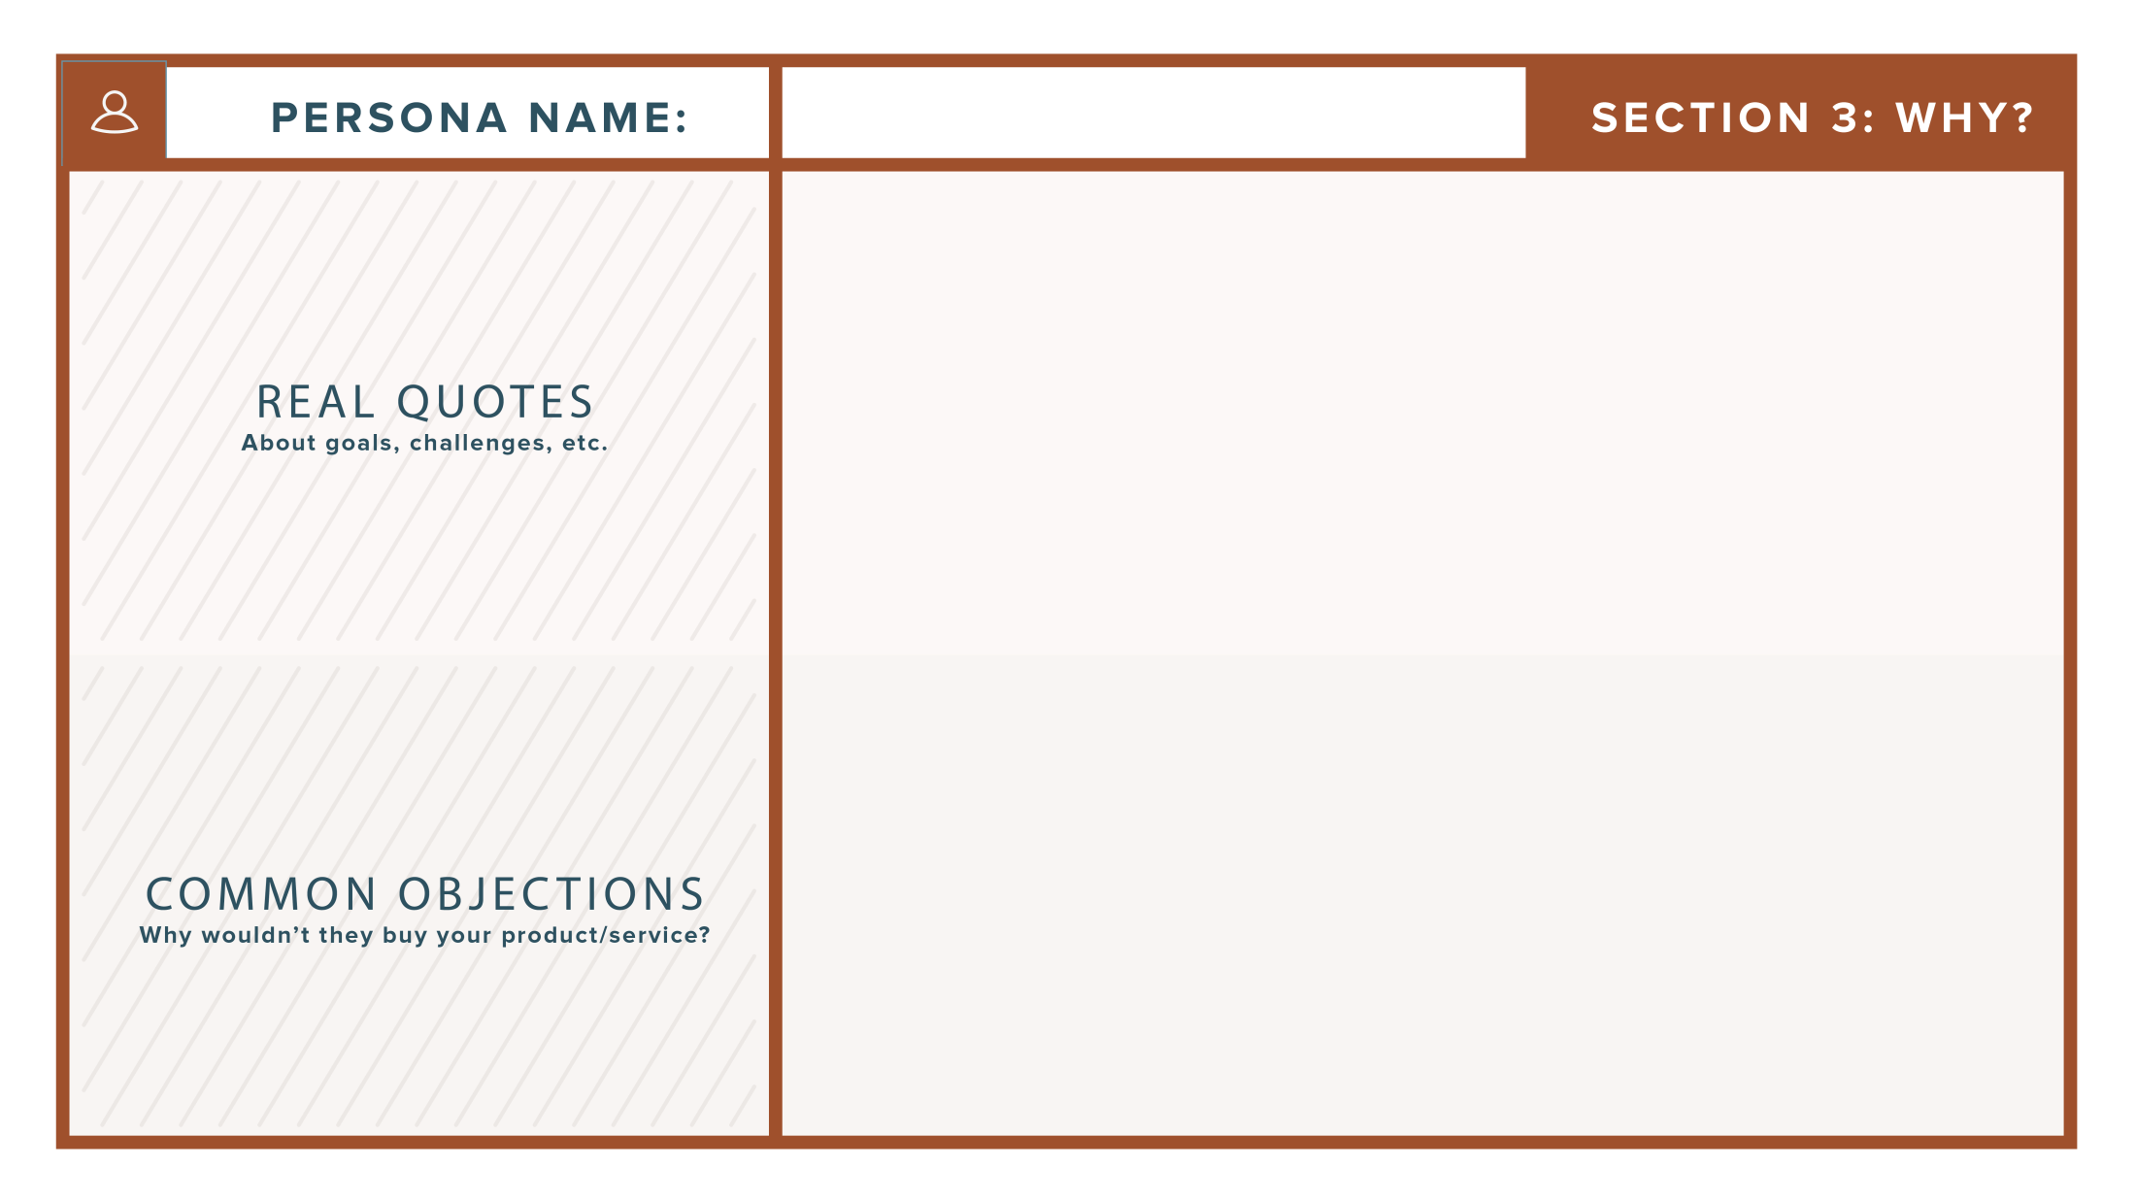
Aby Anna
Main goal is maximum sale and revenue increase of company. Verification of zonal performance, taking steps to increase performance.
Coordination of team some times biggest head ache.
Poor quality or availability of similar quality product with lowest rates.

Slide 15
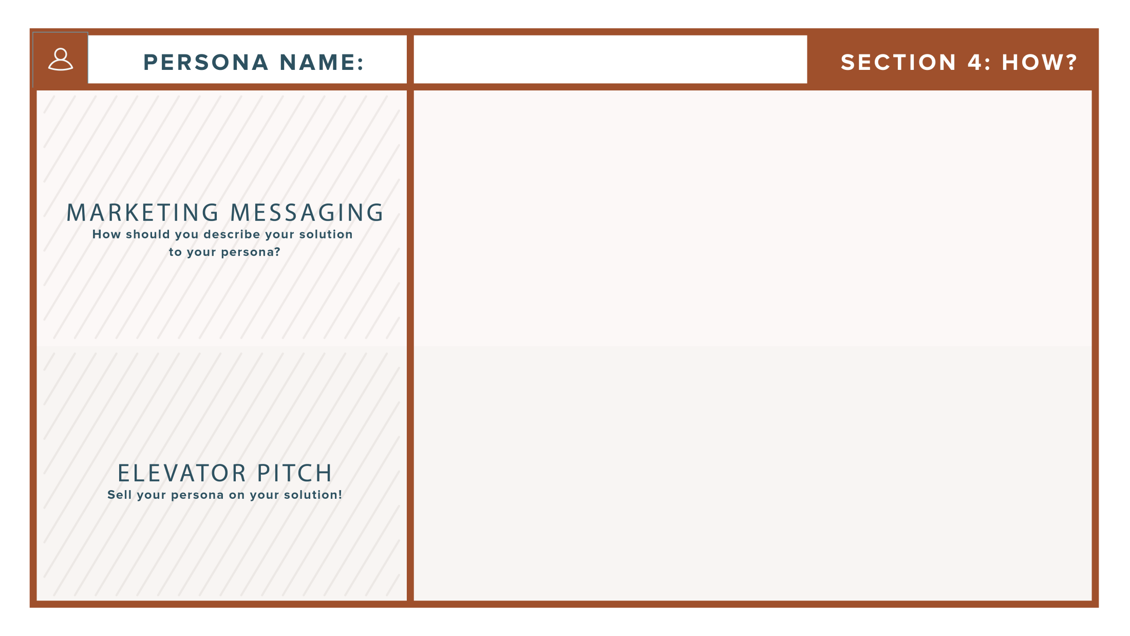
Aby Anna
Zonal marketing managemnt
A marketing Manager or Team leader for single zonal.

